Slide 1
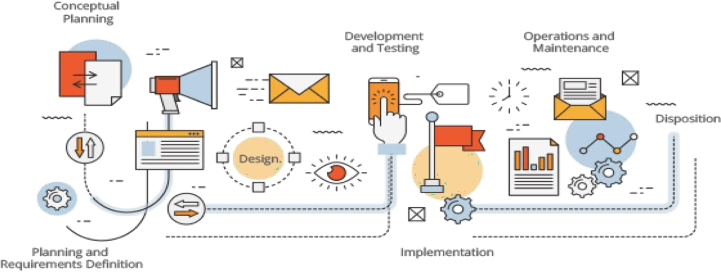

Software Engineering
Requirement Engineering
Dr. Syeda Javaria Imtiaz
CS 3009 - Software Engineering
NATIONAL UNIVERSITY OF
COMPUTING AND EMERGING SCIENCES

Slide 2
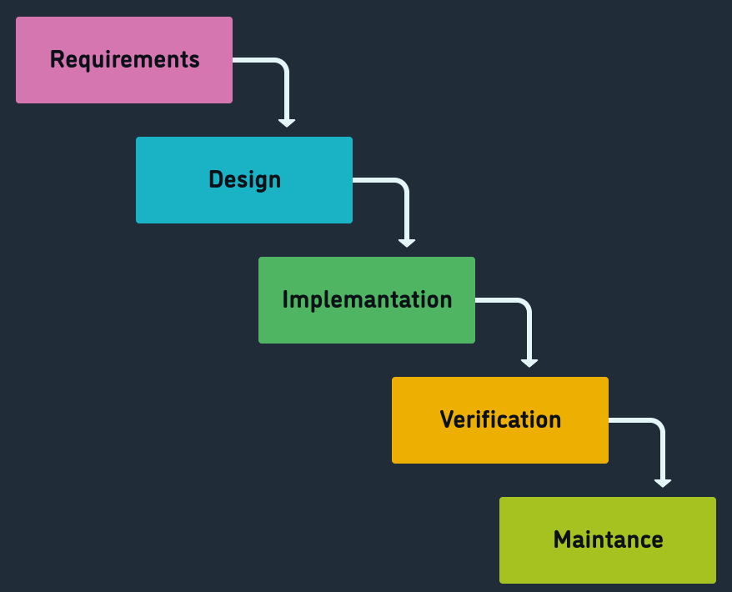
Phases of the Software Development Life Cycle

Slide 3
“The hardest single part of building a software system is deciding what to build...No other part of the work so cripples the resulting system if done wrong. No other part is difficult to rectify later”
-Fred Brooks
Dr. Syeda Javaria Imtiaz
CS 3009 - Software Engineering

Slide 4
Problems
Need to figure out what customer wants
  Not make false/incorrect assumptions
Need to chunk work into bite-sized pieces
  So work can be divided up
  So system can be built incrementally
  So estimates are remotely accurate

Slide 5
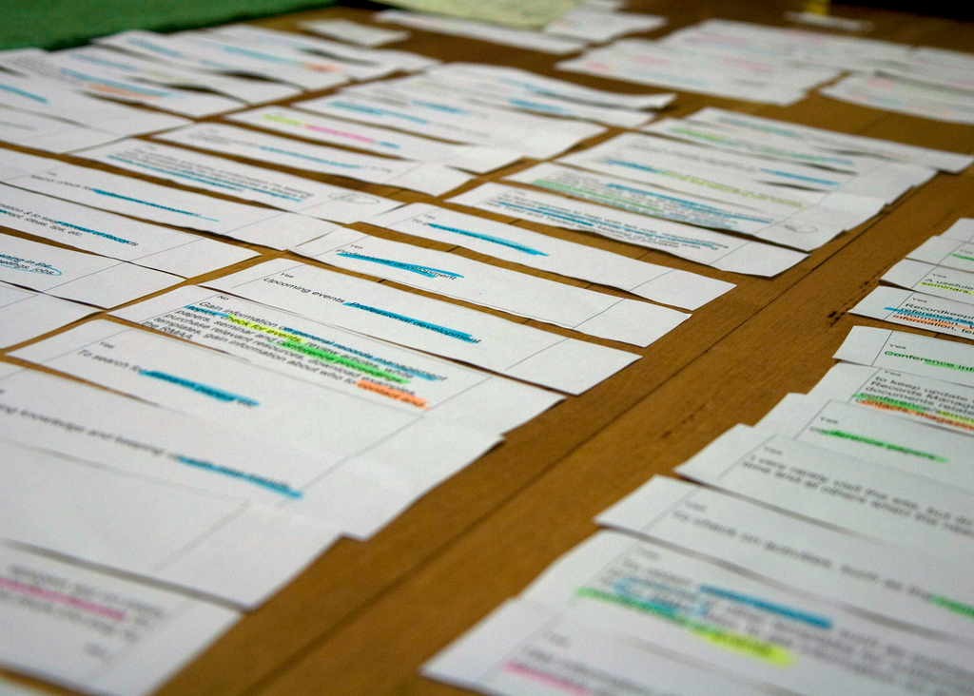
User stories
“Plan using units of customer-visible functionality.”
Quote from Kent Beck’s Extreme Programming Explained (2005).

Slide 6
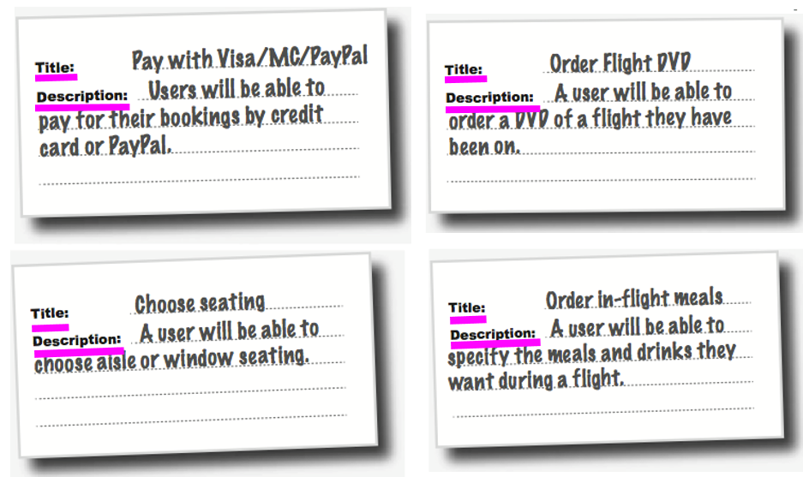
Flight-Booking System Example
Two parts: title and description

Slide 7
Requirement Engineering

Slide 8
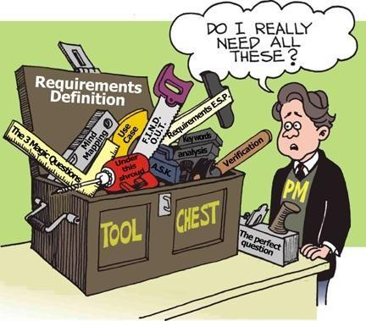
Requirement?
A condition or capability that must be possessed by a system to satisfy a contract or specification, or other formal document – IEEE std 729
NATIONAL UNIVERSITY OF
COMPUTING AND EMERGING SCIENCES

Slide 9
Examples of Requirements
The system shall maintain the record of all payments made to employees on account of salaries, bonuses, travel/daily allowances, medical allowances, etc.
The system shall interface with the central computer to send daily sales and inventory data from every retail store
NATIONAL UNIVERSITY OF
COMPUTING AND EMERGING SCIENCES

Slide 10
Requirements Engineering
The process of establishing the services that the customer requires from a system and the constraints under which it operates and is developed.
The requirements themselves are the descriptions of the system services and constraints that are generated during the requirements engineering process

Slide 11
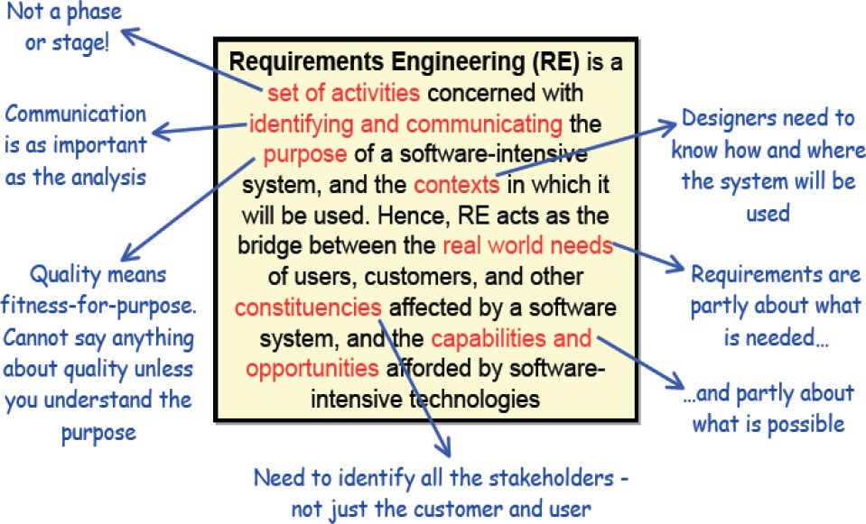
Definition of Requirement Engineering

Slide 12
Types of requirement
User requirements
Statements in natural language plus diagrams of the services the system
provides and its operational constraints. Written for customers.
System requirements
A structured document setting out detailed descriptions of the system’s functions, services and operational constraints. Defines what should be implemented so may be part of a contract between client and contractor.

Slide 13
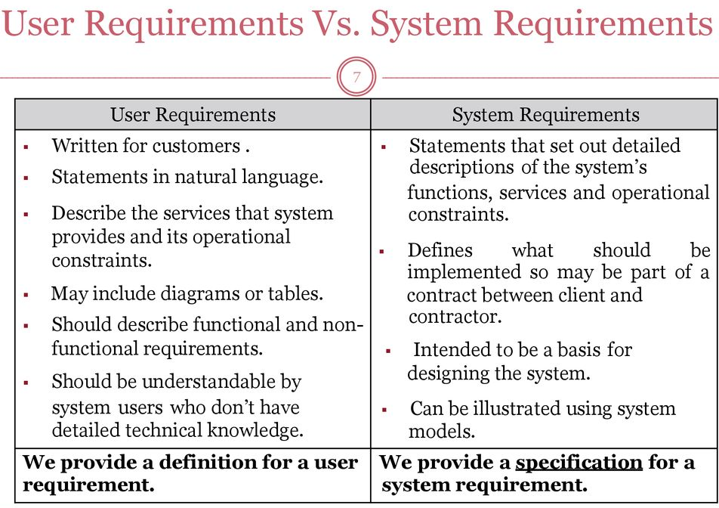

Slide 14
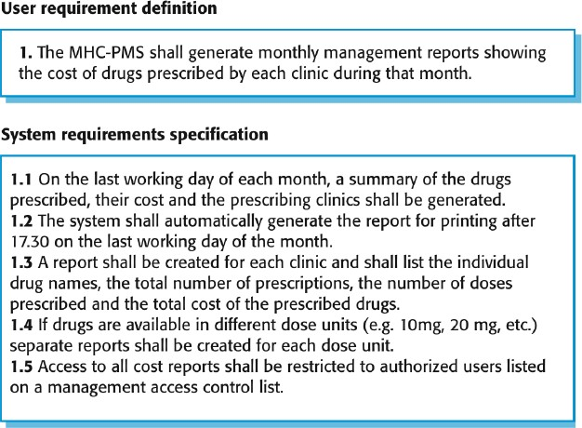
User and system requirements

Slide 15
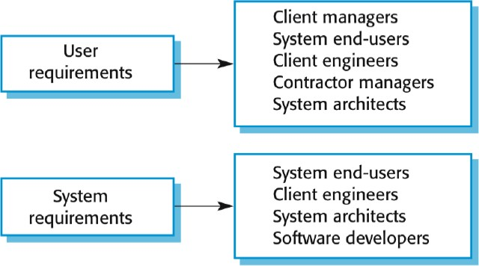
Readers of different types of requirements specification

Slide 16
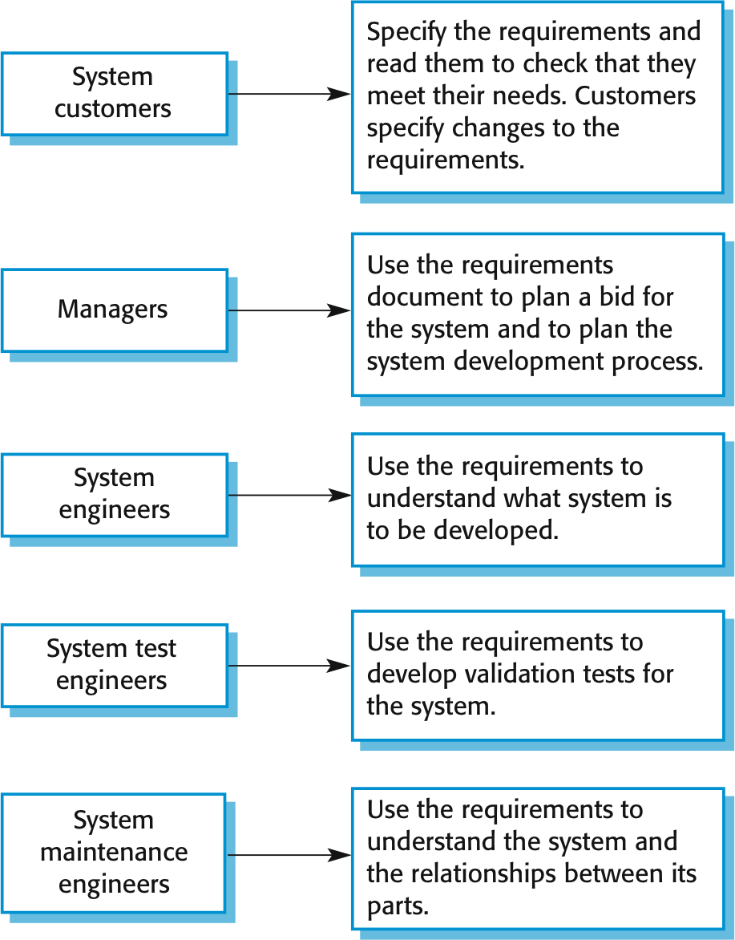
Users of Requirements (Stakeholders)
NATIONAL UNIVERSITY OF
COMPUTING AND EMERGING SCIENCES

Slide 17
Requirement Engineering
Systematic process
Core activities
  Elicitation
  Analysis and Documentation
  Validation
  Management
NATIONAL UNIVERSITY OF
COMPUTING AND EMERGING SCIENCES

Slide 18
Requirements
Communication
  Verbal vs non-verbal
  Formal vs informal
Qualities of RE
NATIONAL UNIVERSITY OF
COMPUTING AND EMERGING SCIENCES

Slide 19
Type of Requirements
Functional requirements
Non functional requirements
Domain requirements (constraints)
NATIONAL UNIVERSITY OF
COMPUTING AND EMERGING SCIENCES

Slide 20
Type of Requirements
Functional requirements
    Statements of services the system should provide, how the system should react to particular inputs and how the system should behave in particular situations
    May state what the system should not do
Non functional requirements
      These define system properties and constraints e.g. reliability, response time, and storage requirements. Constraints are I/O device capability, system representations, etc.
      Non functional requirements may be more critical than functional requirements. If these are not met, the system may be useless.
Domain requirements
  Domain requirements are expectations related to a particular type of software, purpose or industry vertical.

Slide 21
Functional requirements
A functional requirement is a statement of what a product (system, subsystem, system component, device or software program) must do.
Example: The control system shall prevent engine overspeed.

Slide 22
Functional Requirements – HMS
A user shall be able to search the appointments lists for all clinics
The system shall generate each day, for each clinic, a list of patients who are expected to attend appointments that day
Each staff member using the system shall be uniquely identified by his or her 8-digit employee number
NATIONAL UNIVERSITY OF
COMPUTING AND EMERGING SCIENCES

Slide 23
Non-functional Requirements
These define system properties and constraints e.g. reliability, response time, and storage requirements. Constraints are I/O device capability, system representations, etc.
Process requirements may also be specified mandating a particular IDE, programming language or development method.
Non-functional requirements may be more critical than functional requirements. If these are not met, the system may be useless.
NATIONAL UNIVERSITY OF
COMPUTING AND EMERGING SCIENCES

Slide 24
Examples of Non-functional Requirements
Each page must load within 2 seconds.
The process must finish within 3 hours so data is available by 8 a.m. local time after an overnight update.
The system must meet Web Content Accessibility Guidelines WCAG 2.1.
Database security must meet HIPAA requirements.
NATIONAL UNIVERSITY OF
COMPUTING AND EMERGING SCIENCES

Slide 25
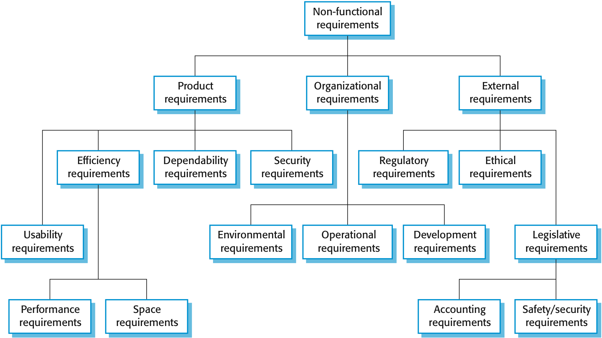
Types of Non-functional Requirements
NATIONAL UNIVERSITY OF
COMPUTING AND EMERGING SCIENCES

Slide 26
Non functional classifications
Product requirements
Organizational
requirements
External requirements
Requirements which specify that the delivered product must behave in a particular way e.g. execution speed, reliability, etc.
Requirements which are a consequence of organizational policies and procedures e.g. process standards used, implementation requirements, etc.
Requirements which arise from factors which are external to the system and its development process,
e.g. interoperability requirements, legislative requirements, etc.

Slide 27
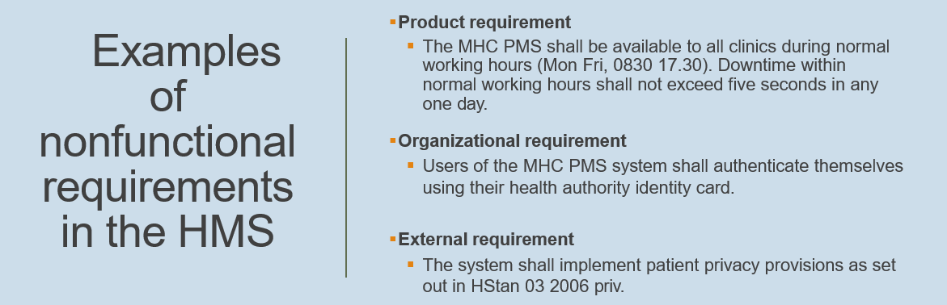
Non- Functional Requirements – Example
NATIONAL UNIVERSITY OF
COMPUTING AND EMERGING SCIENCES

Slide 28
Non-Functional Requirements – Metrics
Property | Measure
Speed | Processed transactions/second, User/event response time, Screen refresh time
Size | Mbytes, Number of ROM chips
Ease of use | Training time, Number of help frames
Reliability | Mean time to failure, Probability of unavailability, Rate of failure occurrence
Robustness | Time to restart after failure, Percentage of events causing failure, Probability of data corruption on failure
Portability | Percentage of target dependent statements, Number of target systems
Availability | Availability of the system over time – e.g., 24hr/day
NATIONAL UNIVERSITY OF
COMPUTING AND EMERGING SCIENCES

Slide 29
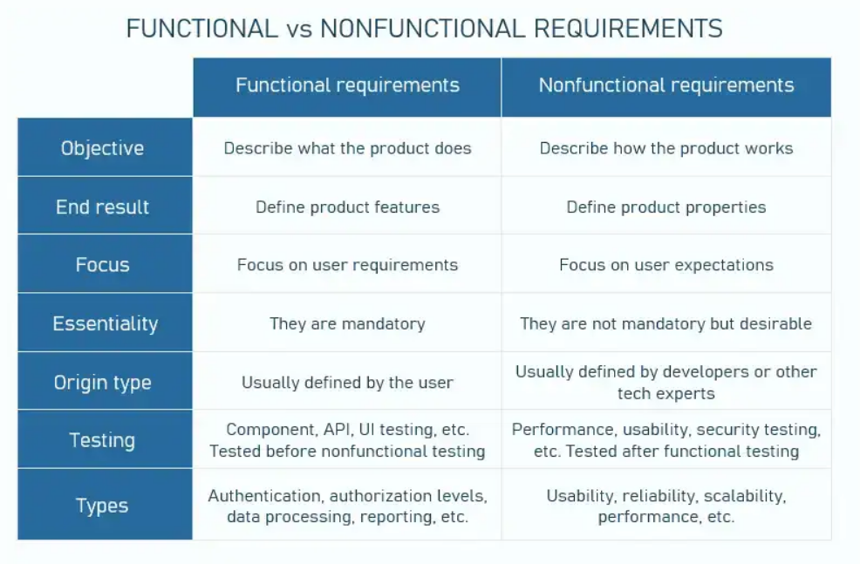
Notes:
https://www.cs.ccsu.edu/~stan/classes/CS410/Notes16/04-Requirements.html

Slide 30
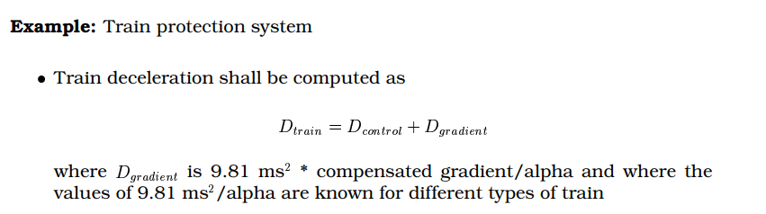
Domain requirements
Domain requirements reflect the environment in which the system operates so, when we talk about an application domain we mean environments such as train operation, medical records, e-commerce etc.
Describe system characteristics and features that reflect the domain
May be new functional requirements, constraints on existing requirements or may define specific computations
If domain requirements are not satisfied, the system may be unworkable

